Slide 1
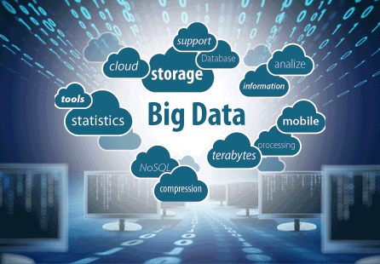
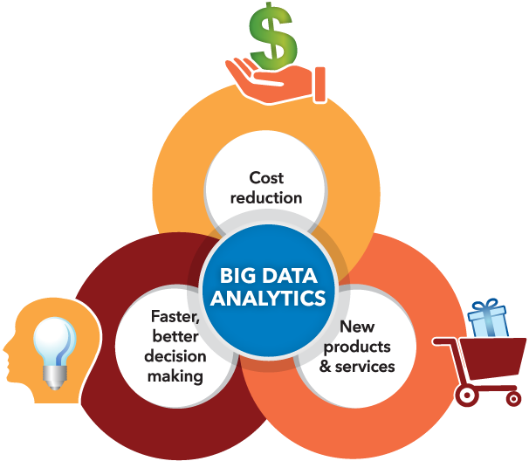
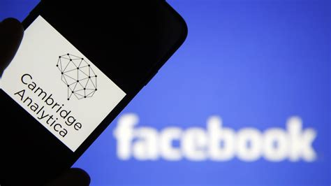
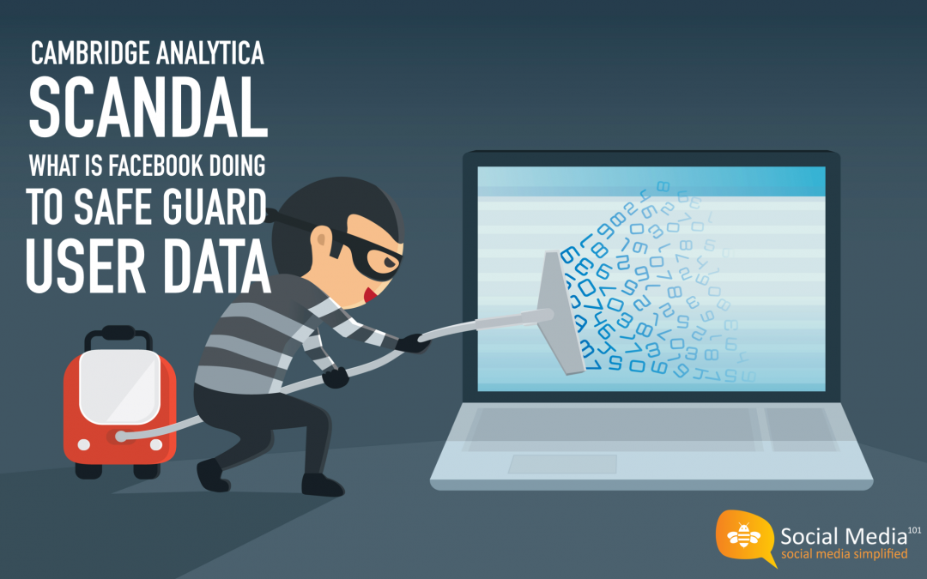
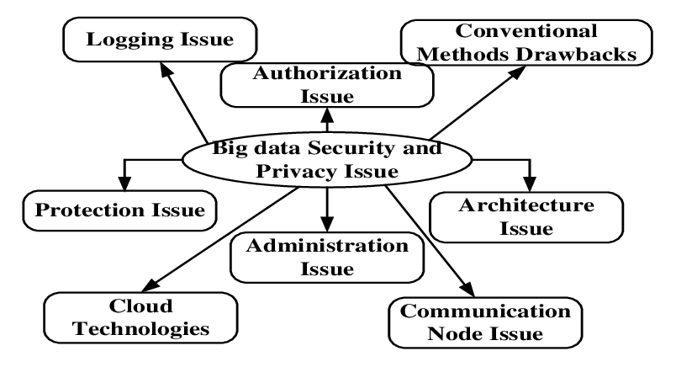
Big Data Analytics
Big Data Analytics is extremely
popular amongst companies as it
boasts many advantages to
becoming a successful business.
With the creation of new technologies there is an increasing amount of big data that can be used each and every day.
Big Data Analytics can be abused by firms with unethical practices, taking information without the users proper consent and using that data to influence their decision making with often massive effects, it is important big Data is only used ethically. To better consumer experience and business decision making
Privacy is of the utmost importance when dealing with the large amounts of data that big data analytics deals with. This can be seen in industries such as the healthcare industry where they have to be very careful with dealing with private details of a patient

